Slide 1

IPL PREDICTON 2024
GUIDED BY : Mr R.DHAMODHARAN
Presented by
S.SIVARANJINI(9922146013)
II M.sc DATA SCIENCE

Slide 2
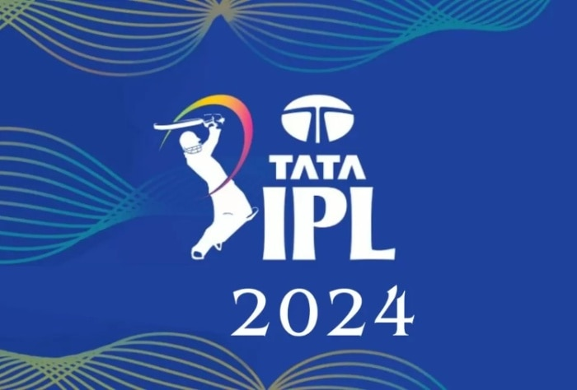
AGENDA
ABSTRACT
PROBLEM STATEMENT
MODULE DESCRIPTION
DATAFLOW DIAGRAM
CODING
REFERENCES
1

Slide 3
ABSTRACT
India's most popular sport is cricket and is played across all over the nation in different formats like T20, ODI, and Test. The Indian Premier League (IPL) is a national cricket match where players are drawn from regional teams of India, National Team and also from international team.
The predictive analysis is grounded in historical match data, encompassing a wide range of variables such as team compositions, player performance statistics, match locations, and weather conditions factors that significantly influence cricket match outcomes. We can predict the match between two teams based on various factors like team composition, batting and bowling averages of each player in the team, and the team's success in their previous matches, in addition to traditional factors such as toss, venue, and day-night, the probability of winning by batting first at a specified match venue against a specific team.
In this project, we have proposed a model for predicting outcome of the IPL matches using Machine learning Algorithm Random Forest Classifier (RFC) .
2

Slide 4
PROBLEM STATEMENT
The problem statement for predicting IPL 2024 involves addressing the challenges inherent in accurately forecasting cricket match outcomes, team performances, and player contributions in the dynamic environment of the Indian Premier League.
The primary issues to be tackled include the volatility of cricket, the rapid changes in player form and team strategies, and the influence of unforeseen events on match results. The goal is to develop a predictive model that not only considers historical data but also adapts in real-time to the evolving dynamics of IPL 2024.
Additionally, the system should account for the psychological aspects impacting player and team performances, handle uncertainties effectively, and mitigate biases introduced by external factors like betting markets. The problem statement seeks a comprehensive and adaptive approach to IPL prediction that embraces the complexities of the sport and leverages advanced analytics to provide valuable insights for enthusiasts, analysts, and stakeholders during the upcoming IPL 2024 season.
4

Slide 5
HARDWARE AND SOFTWARE REQUIREMENTS
Hardware: Standard computing equipment with a minimum of 8GB RAM and a multi-core processor.
Software: Python 3.x, Jupyter Notebook, pandas for data manipulation, matplotlib and seaborn for visualization, and additional libraries as needed for advanced analytics.
4

Slide 6
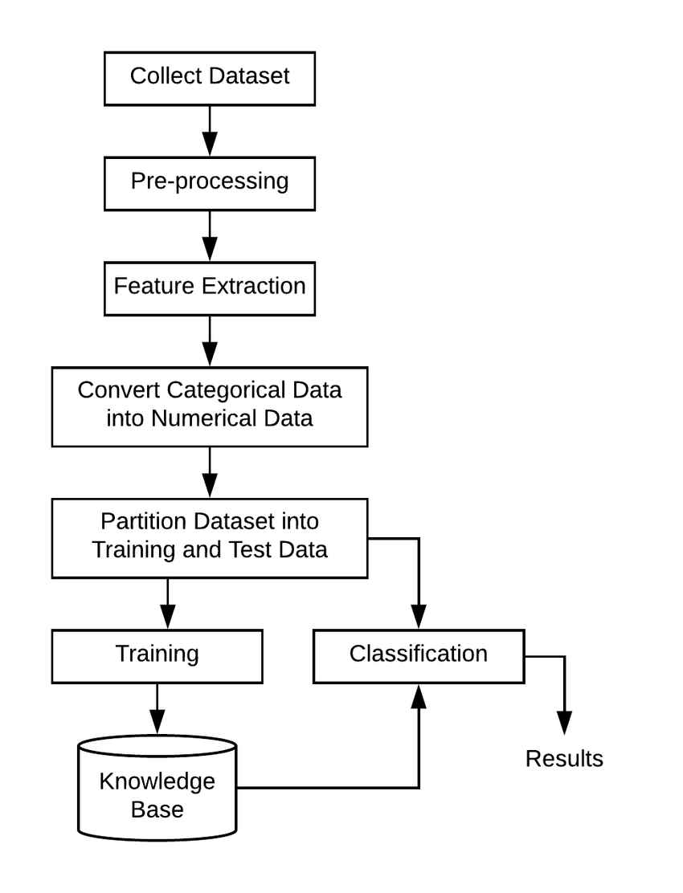
DATAFLOW DIAGRAM
4

Slide 7
MODULE DESCRIPTION
DATA CLEANING MODULE:
Data Cleaning Module: Cleans the dataset by handling missing values, removing unnecessary columns, and normalizing data formats. The Data Cleaning Module is foundational to ensuring the integrity and usability of the dataset. This module undertakes several critical tasks to prepare the data for analysis.
Handling Missing Values: Identifies and addresses gaps in the dataset, either by imputing values based on statistical methods (like using the median for numerical data) or by removing rows/columns with excessive missing data, depending on their significance to the analysis.
Removing Unnecessary Columns: Streamlines the dataset by eliminating columns that do not contribute to the analysis objectives. This step simplifies the dataset, making it more manageable and focused on the relevant data. Ensures consistency across the dataset, particularly for date and time formats, numerical data, and categorical data. This normalization facilitates accurate comparisons and analyses in subsequent modules.
4

Slide 8
VISUALIZATION MODULE
Utilizing Matplotlib and Seaborn: These libraries offer a wide range of plotting functions for creating clear, informative visualizations. The module leverages these tools to produce charts, graphs, and plots that highlight the key findings from the data exploration phase.
Insightful Visualizations: The focus is on creating visual outputs that convey complex data relationships in a straightforward manner, facilitating easier interpretation and decision-making.
4

Slide 9
VISUALIZATION MODULE
Analysis of Past IPL Seasons
The analysis of past IPL seasons revealed several key trends and patterns that have influenced the performance of teams and players. Historical data showed that teams winning the toss and choosing to chase have had a higher win percentage, highlighting the significance of toss decisions. Player performance analysis indicated that all-rounders and players with high strike rates and economy rates significantly impact their teams' chances of winning. Teams with a balanced composition of experienced and young talents tended to perform better over the season.
4

Slide 10
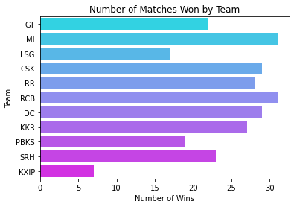
VISUALIZATION MODULE
Analysis of Past IPL Seasons
Most Wins: MI (Mumbai Indians) has the longest bar, indicating it has won the most matches.
High Performers: CSK (Chennai Super Kings) and GT (Gujarat Titans) also have long bars, showing a significant number of wins.
4

Slide 11
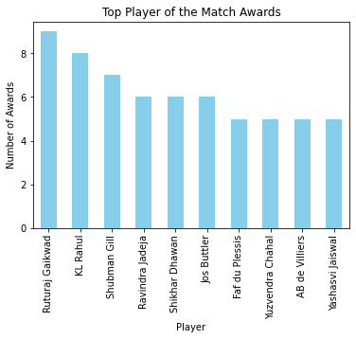
VISUALIZATION MODULE
Analysis of Past IPL Seasons
Ruturaj Gaikwad: Leads with 8 awards, making him the most decorated player.
K.L Rahul: Close behind with 7 awards.
Shubman Gill and Faf du Plessis both have 5 awards each.
Ravindra Jadeja and Jos Buttler share 4 awards.
Shikhar Dhawan has 3 awards.
4

Slide 12
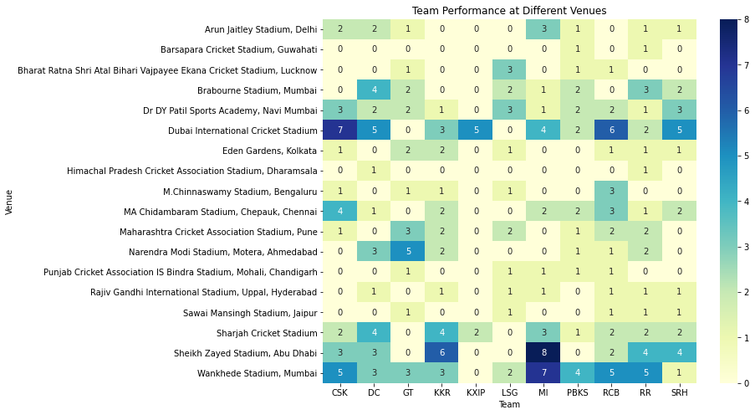
VISUALIZATION MODULE
Analysis of Past IPL Seasons
Chennai Super Kings (CSK):
M. A. Chidambaram Stadium, Chepauk, Chennai: CSK has consistently performed exceptionally well at this venue.
Delhi Capitals (DC):
Arun Jaitley Stadium, Delhi: DC has shown strong performances on their home ground.
Gujarat Titans (GT):
Bharat Ratna Shri Atal Bihari Vajpayee Ekana Cricket Stadium, Lucknow: GT has had favorable results here.
Royal Challengers Bangalore (RCB):
M. Chinnaswamy Stadium, Bengaluru: RCB’s home ground has witnessed thrilling matches.
4

Slide 13
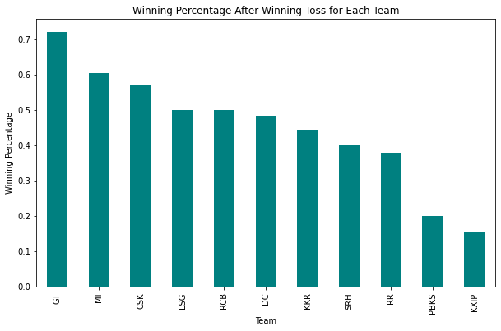
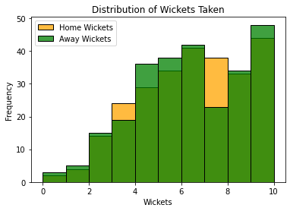
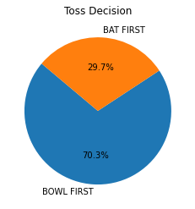
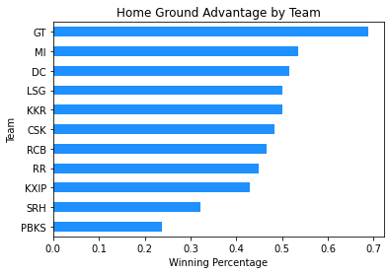
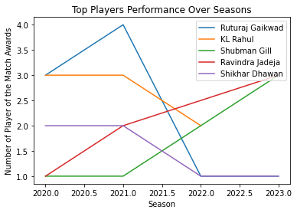

Slide 14
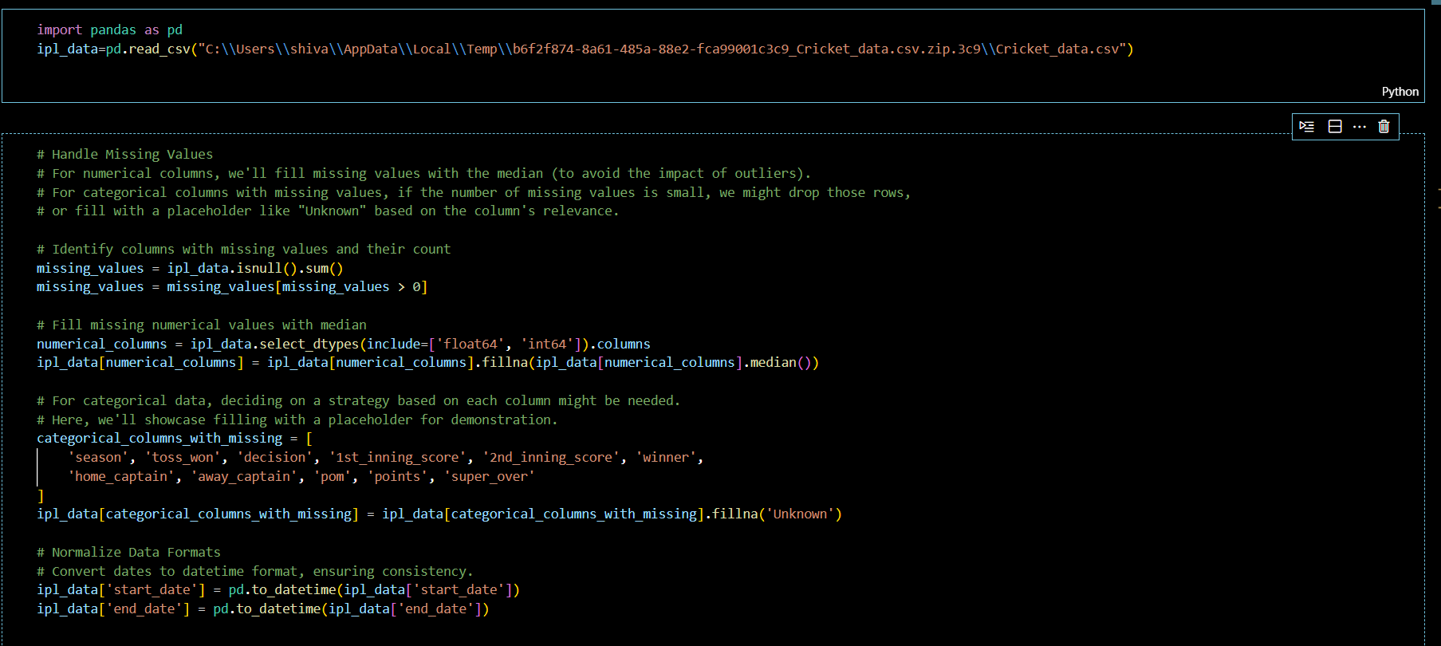
CODING
4

Slide 15
PREDICTIVE MODELING MODULE
Applying Machine Learning Algorithms: Plans to utilize supervised learning algorithms to model and predict outcomes of interest, such as match results or player performances, based on historical data.
Predictive Insights: The goal is to build models that can accurately forecast future events, providing a strategic advantage in planning and decision-making processes. This module would involve data preprocessing, model selection, training, evaluation, and refinement to achieve reliable predictions.
4

Slide 16
PREDICTIVE MODELING MODULE
Random Forest is an ensemble learning method used for both classification and regression tasks. It operates by constructing a multitude of decision trees at training time and outputting the class that is the mode of the classes (classification) or mean prediction (regression) of the individual trees.
Feature Importance: After training, Random Forest provides insights into the importance of each feature in making predictions. In your model, features like 'average_home_runs' and 'toss_won_by_home_team' were used, and Random Forest can indicate how much each of these features contributes to predicting the home team's win.
Model Training: Random Forest was trained using features derived from historical match data. This includes numerical and categorical data, all of which Random Forest can handle effectively.
Prediction: For prediction, the Random Forest model aggregates the predictions made by all the trees within the forest. For classification tasks like predicting the match outcome (win/lose), Random Forest selects the most common outcome predicted by the trees.
Evaluation: The model's performance was evaluated using accuracy and a classification report, which includes precision, recall, and F1-score for each class. This helped in understanding the effectiveness of the model in predicting whether the home team wins based on the input features.
4

Slide 17
FEW REFERENCES
https://www.researchgate.net/publication/355061139_Prediction_of_IPL_Match_Outcome_Using_Machine_Learning_Techniques
https://www.kaggle.com/datasets/prajwaldongre/ipl-players-sold-2024?select=IPL_PLAYERS.csv
Indian Premier League (IPL) Historical Match Data (2008-2023). Retrieved from the Global Sports Data Repository, https://www.globalsportsdatarepo.org/ipl-matches
5

Slide 18

6

